Slide 1
Google Skills

Slide 2
Search with url
Search SCERT Chemistry text book in
website : scert.kerala.gov.in
Search PSC Registration Login page
website : keralapsc.gov.in

Slide 3
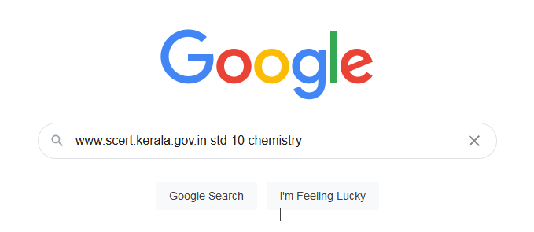
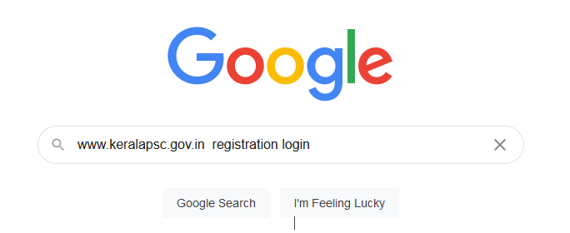

Slide 4
Power of the asterisk
Used to serch

Slide 5
Related:
Used to search related website
related:google.com
related:facebook.com

Slide 6
File Type:
Used to search files like pdf, ppt, doc …
Ubuntu virus filetype:pdf
Ubuntu virus filetype:doc

Slide 7
Search Operators
use +/- sign for searching
chemistry +physics
chemistry -physics

Slide 8
Asterisk *
Search with uncompleted word
Laws of *
newton's * law

Slide 9
Near by
Search an item / service nearest one
dry cleaners nearby
Coffee shop nearby

Slide 10

Image Search
Search an similar type image and details

Slide 11
Define
Search an similar type image and details
define botany

Slide 12
site:
Search with specific website type
DC Motor site:facebook.com
mobile phone site:.edu

Slide 13
intitle:
Search with specific website type
intitle:human heart

Slide 14
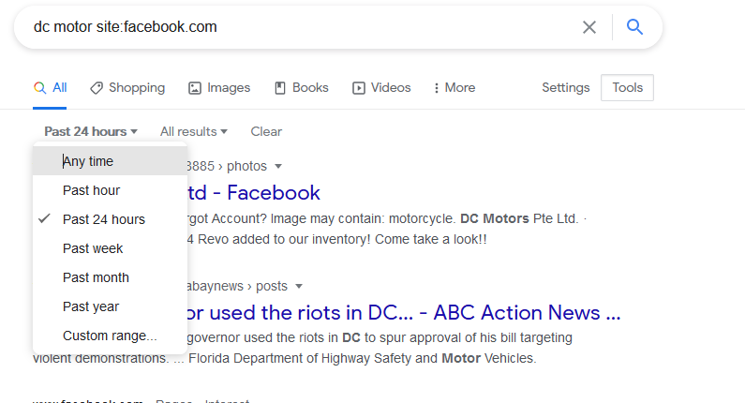
Searching using Date Tool
Sort searching result in order to date

Slide 15
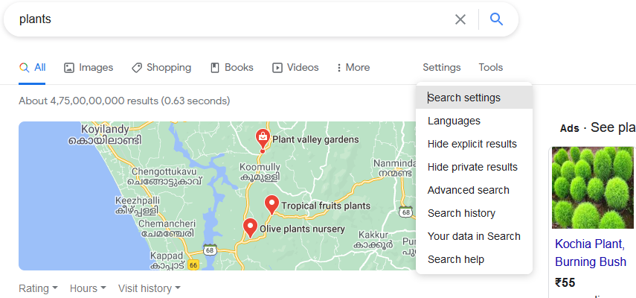
Advance Search settings
Sort searching result in order to date

Slide 16
Spelling check
Search with specific website type
DC Motor site:facebook.com
mobile phone site:.edu

Slide 17
pronounce
Pronounce English word word
pronounce apple
pronounce psychology

Slide 18
[word] in [Language]
To know the word in other language
Water in Malayalam
Water in Arabic

Slide 19
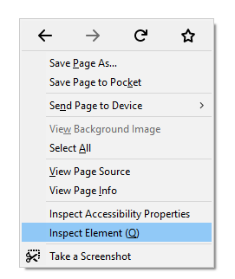
Browser console calculation
Quick calculation

